Slide 1
Dynamic Analysis of Cantilever Beam

Slide 2
Overview
Analytical Solution Details
Solid Rectangular Beam:
Model dimensions
Frequency Analysis
Mode Shapes
Frequency response
Hollow Rectangular Beam:
Model dimension
Frequency Analysis
Mode Shapes
Frequency response

Slide 3





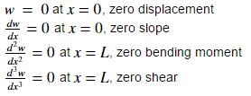
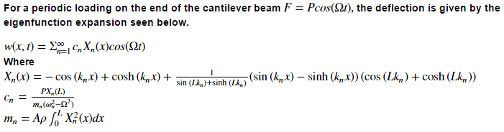
Analytical solution details
ABAQUS results compared to the analytical solution for Euler-Bernoulli beam equation.
Some derivation details provided below.
Spatial portion solved for eigenfrequencies and shapes
Starting with equation below
Assume solution
Applying separation of variables
= 0
= 0
= 0
For the 4th order ODE assume following solution form
Numerically solved for natural frequencies
Plotted for mode shapes
And following B.C.’s

Slide 4

Solid Rectangular Beam (Dimensions)
Load P = 1000 N
and P = 1000cos(Ωt)
Material Properties (Aluminum):
Density = 2711 kg/mm^3
Young’s Modulus = 6.89e10 Pa
Poisson’s Ratio = 0.33
Length L = 1m
b = 0.05m
Load applied to end node. Static and dynamic variants
ABAQUS MODEL
h = 0.05m
X-Section
Node fixed in translation and rotation
Model Details:
21 node, 20 element beam model
Linear beam element from ABAQUS library (B21)

Slide 5
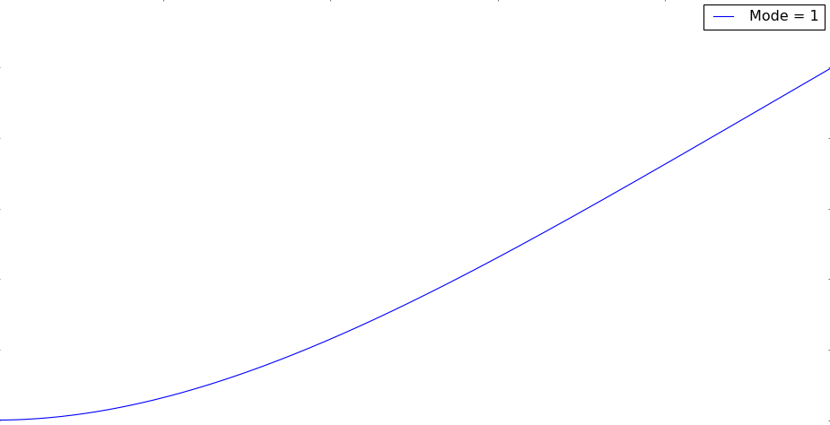
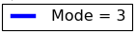
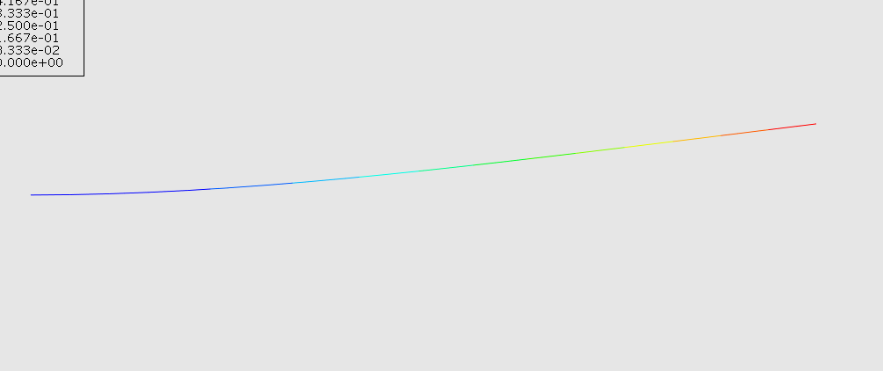
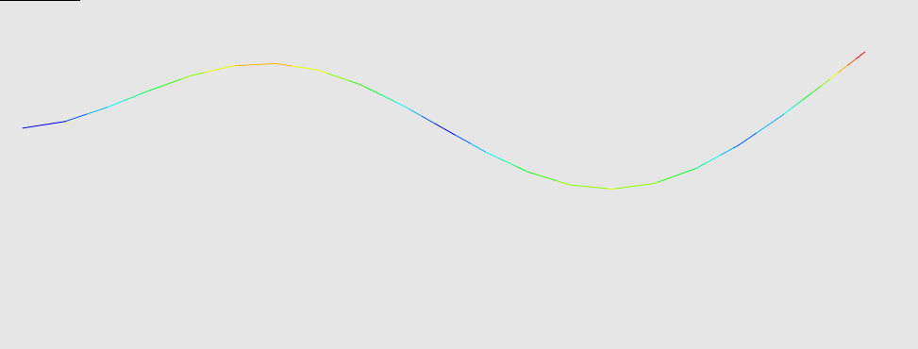
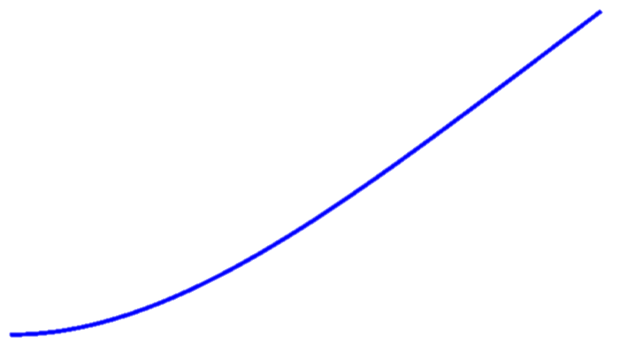
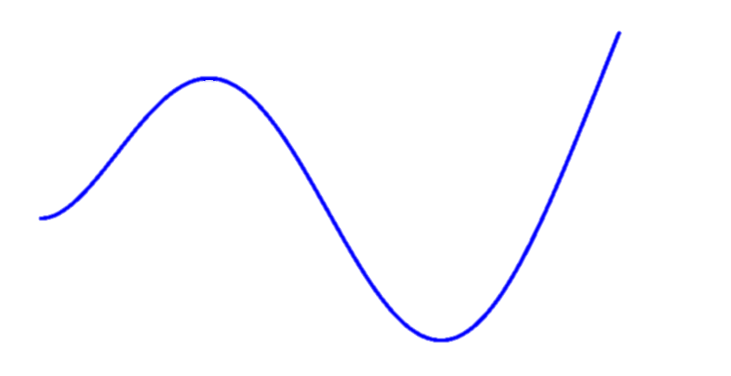
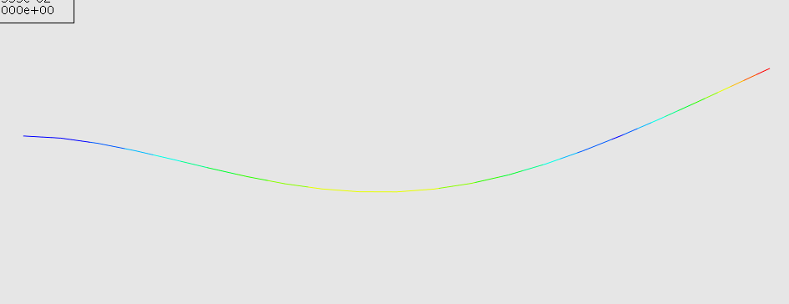
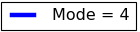

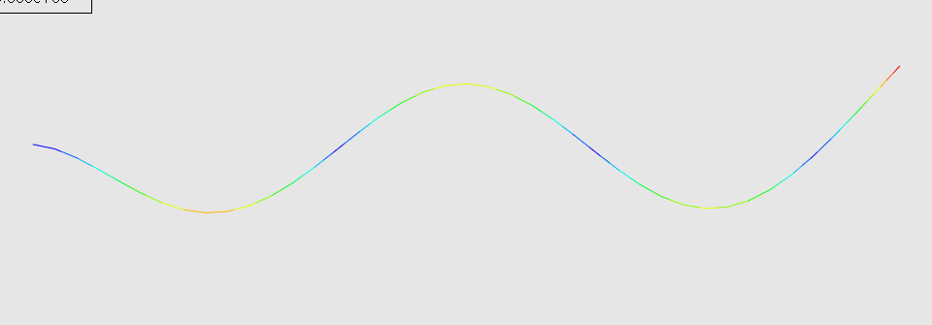
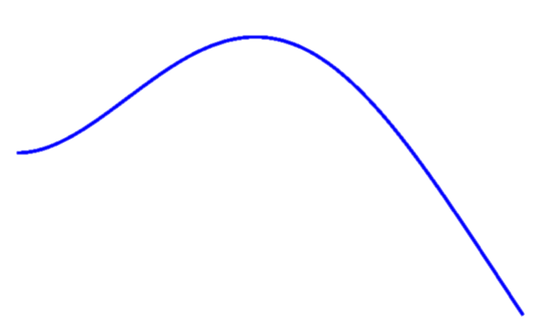
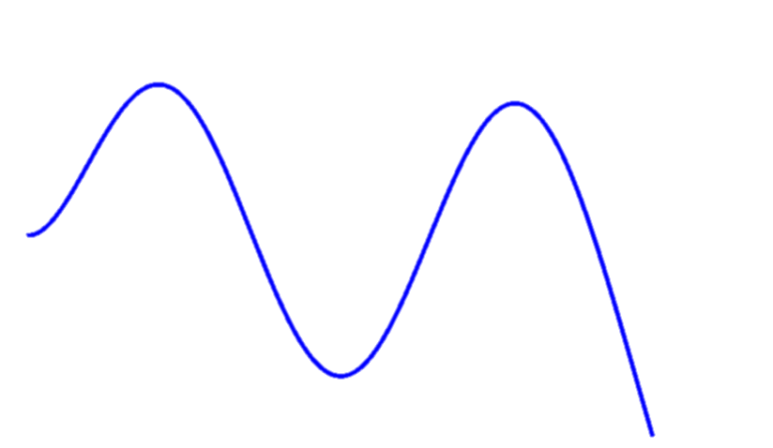
Frequency Analysis – Solid Beam
Mode | Analytical (Hz) | FEA (Hz) | % Error
1 | 40.7 | 40.6 | 0.2
2 | 255.2 | 251.5 | 1.4
3 | 714.5 | 691.2 | 3.3
4 | 1400.2 | 1320.3 | 5.7
Lanczos eigensolver used for FEA analysis
FEA
FEA
Analytical
Analytical
FEA
FEA
Analytical
Analytical

Slide 6
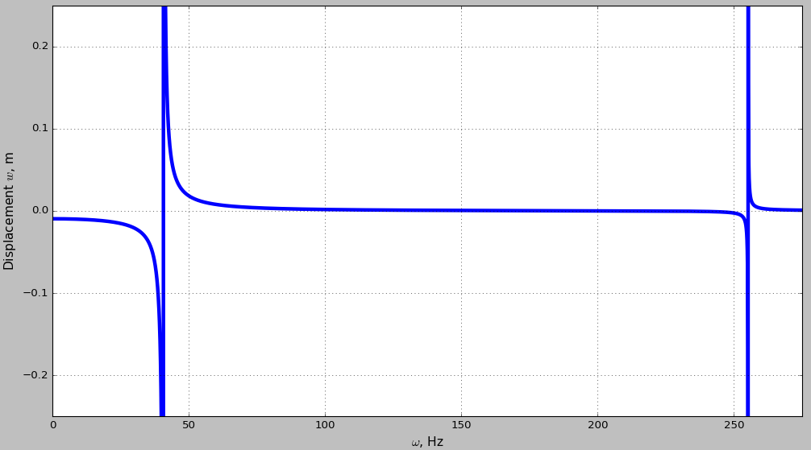
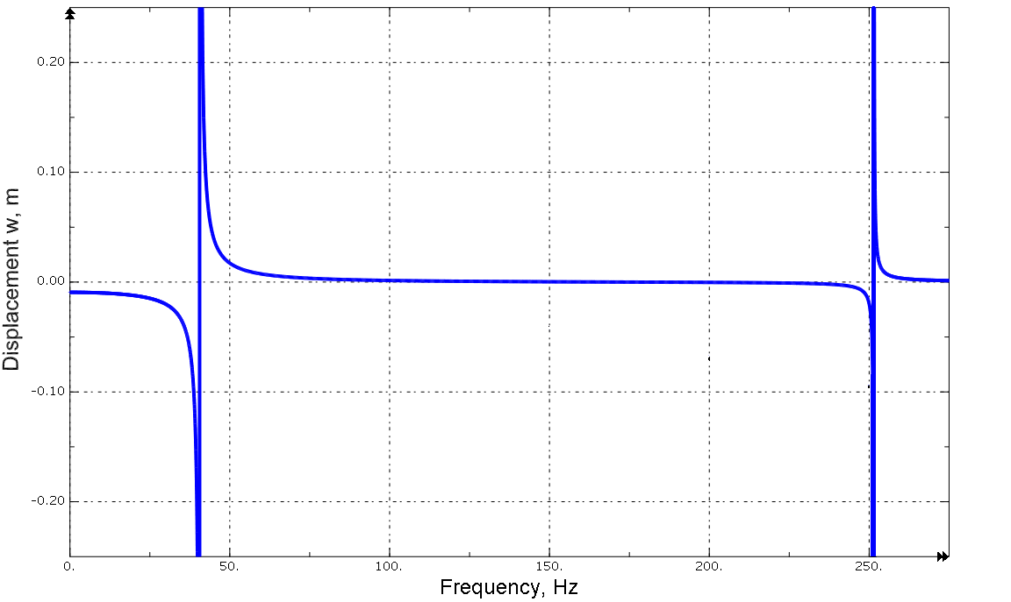
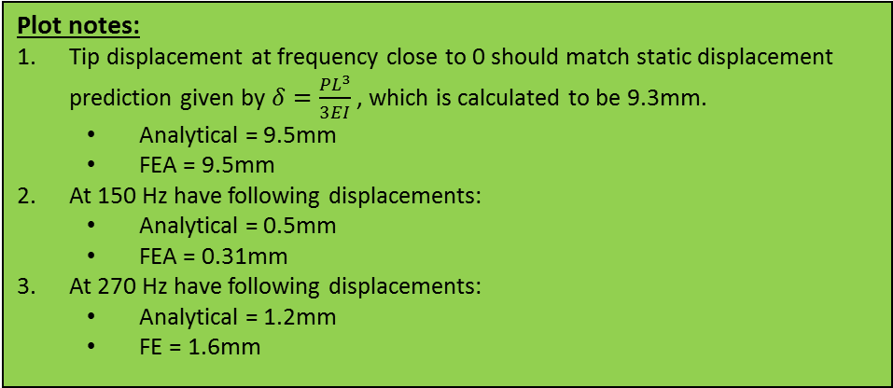
Steady State Dynamic Response – Solid Beam
Analytical Frequency Response Plot
Frequency response measured at the beam tip.
1
2
3
ABAQUS Frequency Response Plot
Plot notes:
Tip displacement at frequency close to 0 should match static displacement prediction given by $δ=\frac{PL^{3}}{3EI}$ , which is calculated to be 9.3mm.
Analytical = 9.5mm
FEA = 9.5mm
At 150 Hz have following displacements:
Analytical = 0.5mm
FEA = 0.31mm
At 270 Hz have following displacements:
Analytical = 1.2mm
FE = 1.6mm
2
1
3

Slide 7
Hollow Rectangular Beam (Dimensions)
Load P = 1000 N
and P = 1000cos(Ωt)
Material Properties (Aluminum):
Density = 2711 kg/mm^3
Young’s Modulus = 6.89e10 Pa
Poisson’s Ratio = 0.33
Length L = 1m
b = 0.05m
Load applied to end node. Static and dynamic variants
ABAQUS MODEL
0.04m
h = 0.05m
X-Section
Node fixed in translation and rotation
Model Details:
21 node, 20 element beam model
Linear beam element from ABAQUS library (B21)

Slide 8
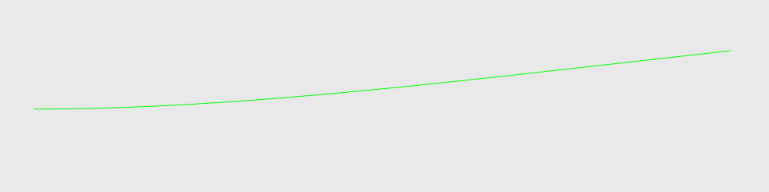
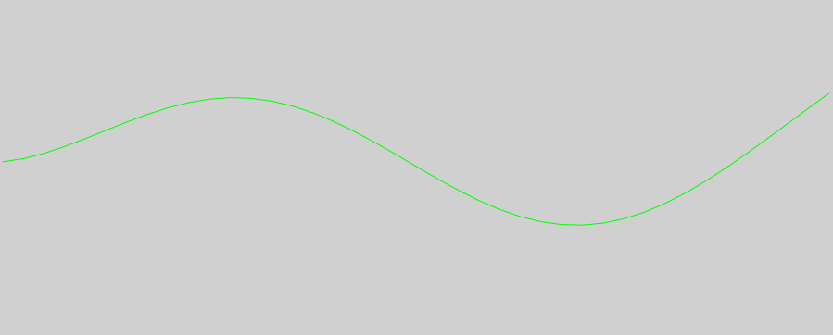
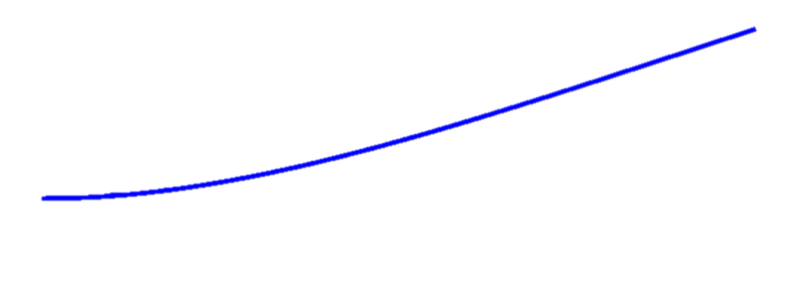
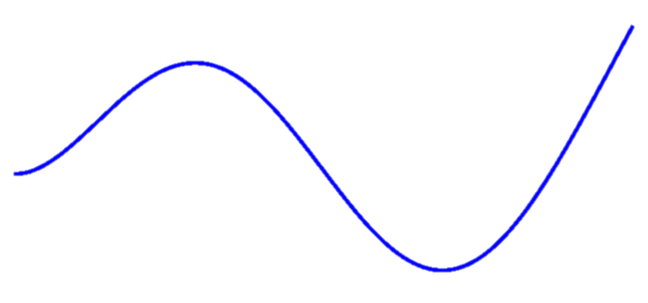
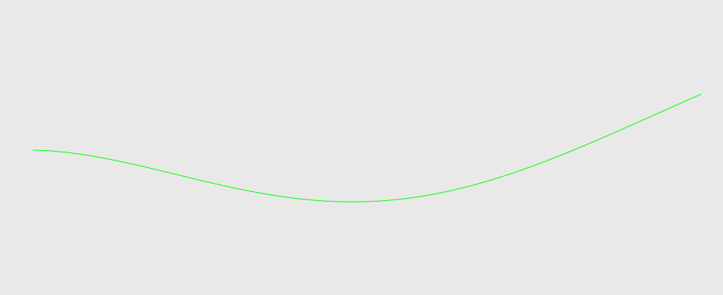
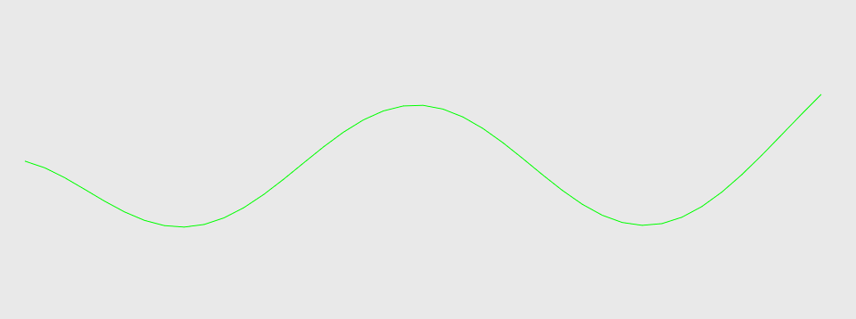
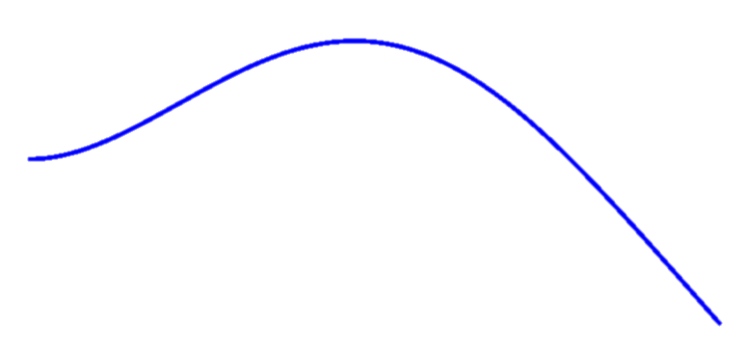
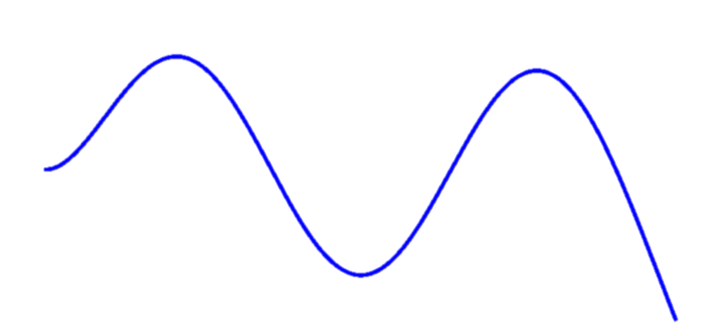
Frequency Analysis – Hollow Beam
Mode | Analytical (Hz) | FEA (Hz) | % Error
1 | 52.1 | 51.5 | 0.6
2 | 326.8 | 312.6 | 4.3
3 | 915.0 | 834.62 | 8.8
4 | 1793.1 | 1538.4 | 14.2
Lanczos eigensolver used for FEA analysis
FEA
FEA
Analytical
Analytical
FEA
FEA
Analytical
Analytical

Slide 9
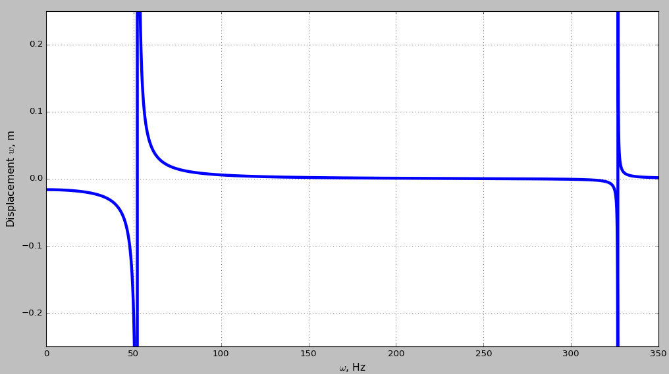
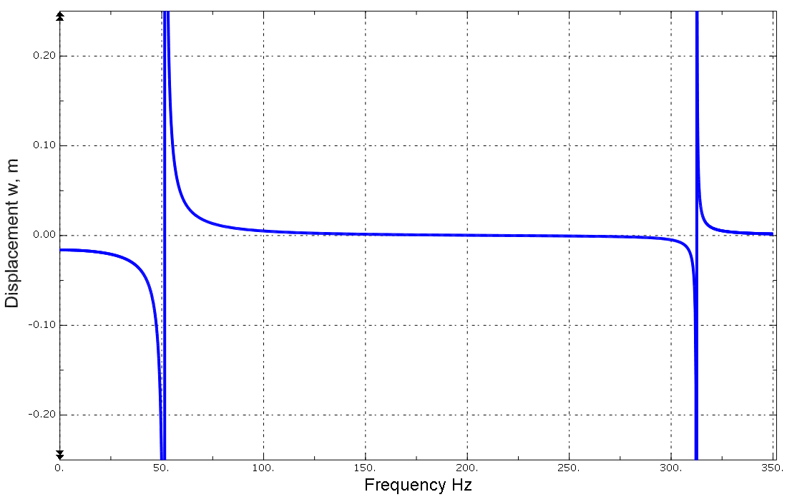
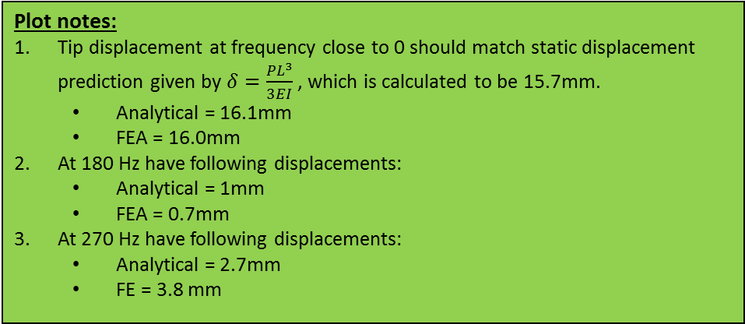
Steady State Dynamic Response – Solid Beam
Analytical Frequency Response Plot
Frequency response measured at the beam tip.
2
3
1
ABAQUS Frequency Response Plot
Plot notes:
Tip displacement at frequency close to 0 should match static displacement prediction given by $δ=\frac{PL^{3}}{3EI}$ , which is calculated to be 15.7mm.
Analytical = 16.1mm
FEA = 16.0mm
At 180 Hz have following displacements:
Analytical = 1mm
FEA = 0.7mm
At 270 Hz have following displacements:
Analytical = 2.7mm
FE = 3.8 mm
2
3
1

